Slide 1
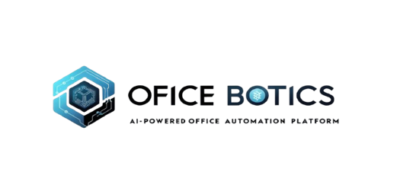
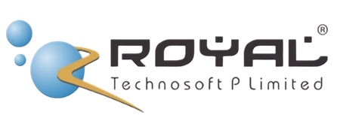
OFFICE
BOTICS
Redefining work space with intelligence

Slide 2




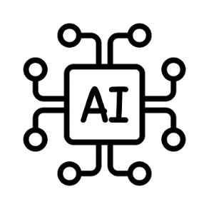

About Company
Driving innovation and efficiency to create smarter, more productive workplaces.
Leveraging artificial intelligence to automate tasks, optimize workflows, and enhance decision-making.
Integrating intelligent technologies to streamline operations, improve security, and boost employee productivity.

Slide 3
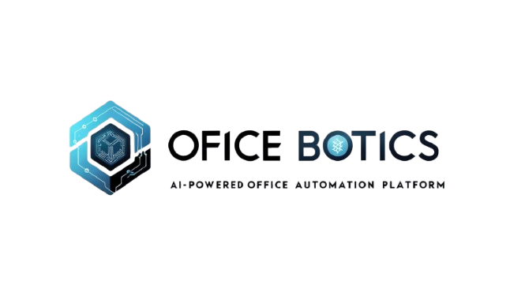

The Problem
Low Productivity & Time Management Issues ⏳
Lack of Automation & Repetitive Work 🔄
Poor Decision-Making 📉
Security & Data Breaches 🔓
Employee Burnout & Low Engagement ⚡
Limited Remote Work Capabilities 🌍
Lack of Personalization in Training 🎓

Slide 4
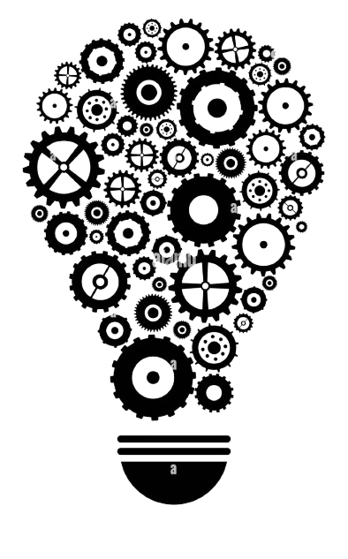
Our Solution
Smart Task Automation & Reminders 🕒
AI-Driven Decision Support 📊
Advanced Security & Authentication 🔒
Employee Well-being & Break Time Alerts ☕
Seamless Virtual Office Accessibility 🌐
Personalized AI Training & Learning 🎓

Slide 5

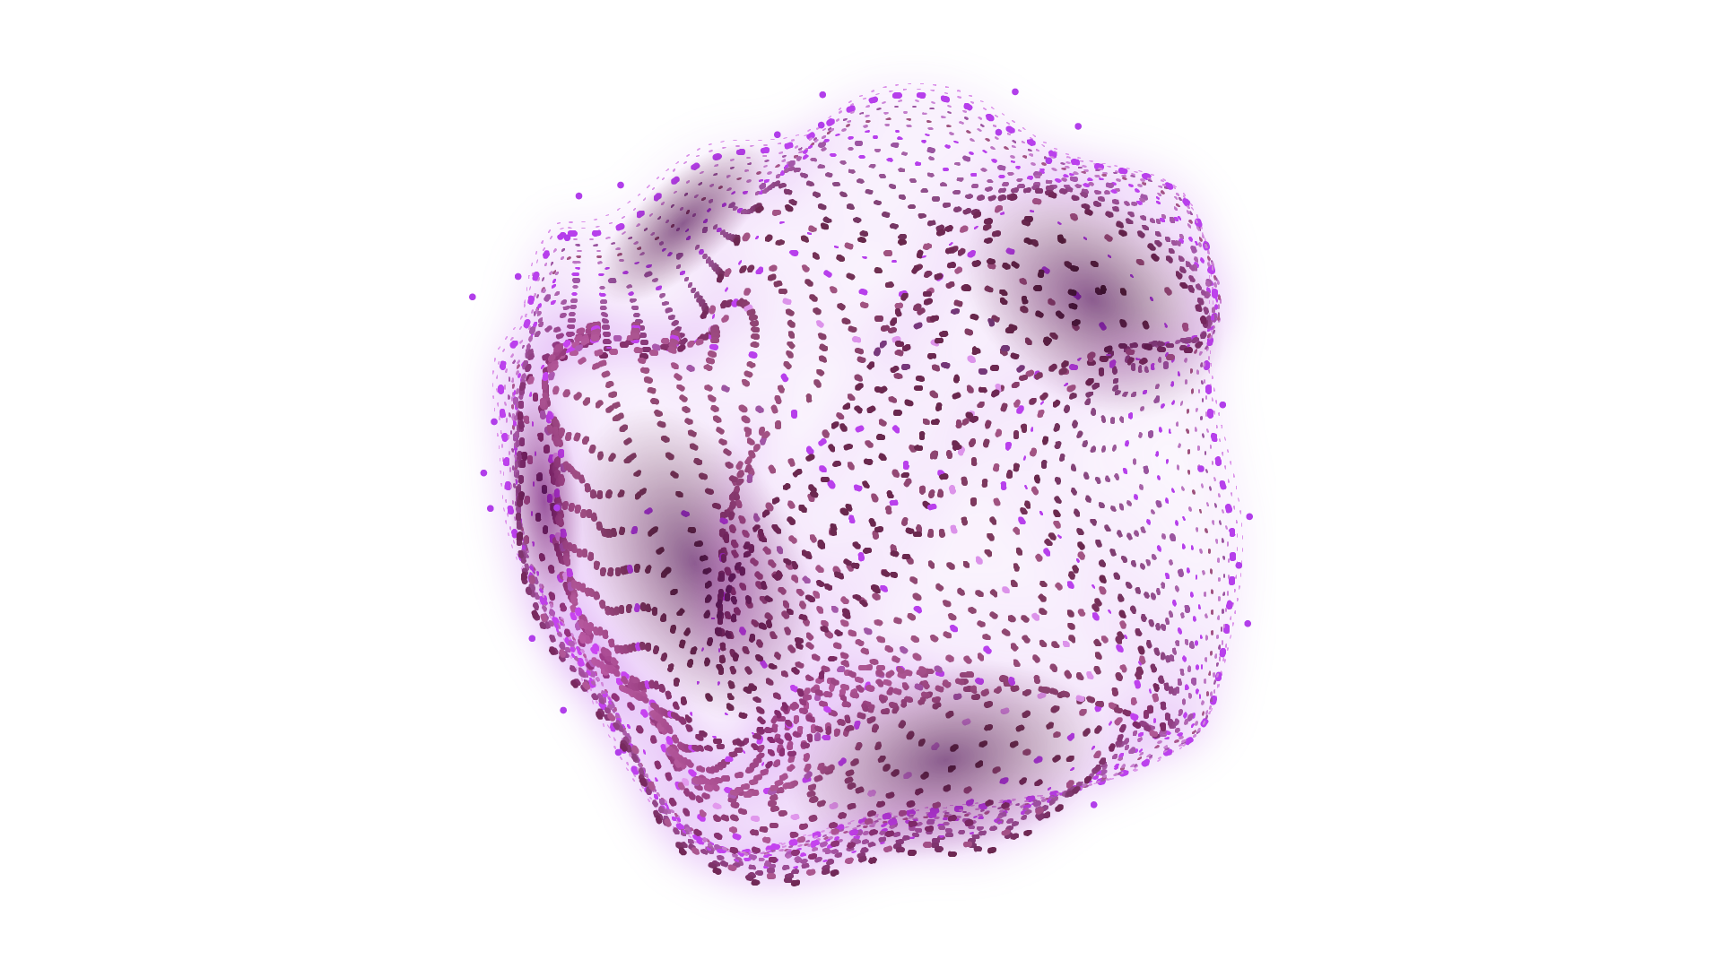
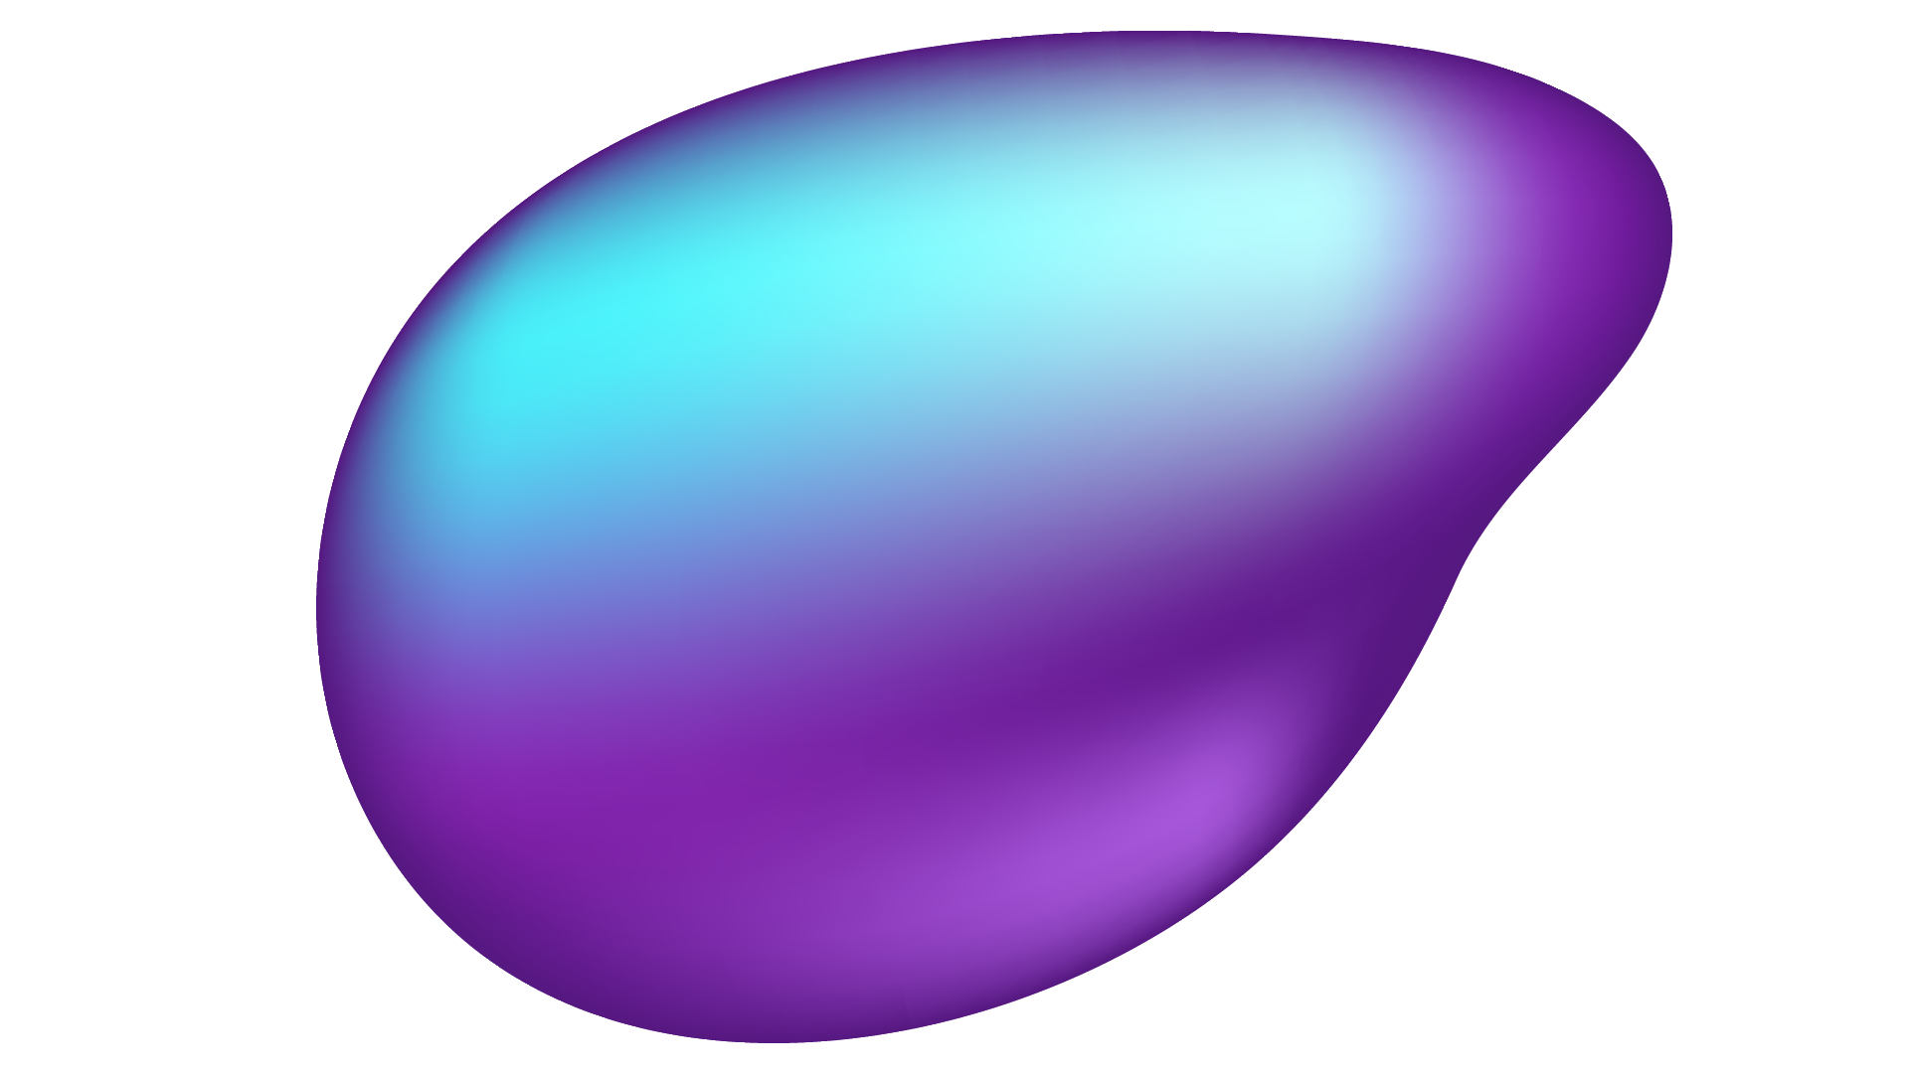
PrepBot – Interview Preapration Bot
🔹 Purpose – 🎯 Helps users prepare for HR and technical interviews with AI-driven assistance.
🔹 Interview Type Selection – 🔄 Users can choose between HR or technical interview practice.
🔹 Interactive Q&A – 💬 Users can ask any interview-related questions or queries.
🔹 AI-Generated Responses – 🤖 Provides relevant recommendations and tips for better answers.
🔹 User-Friendly Interface – ✅ Designed for easy and effective interaction, making preparation seamless.

Slide 6
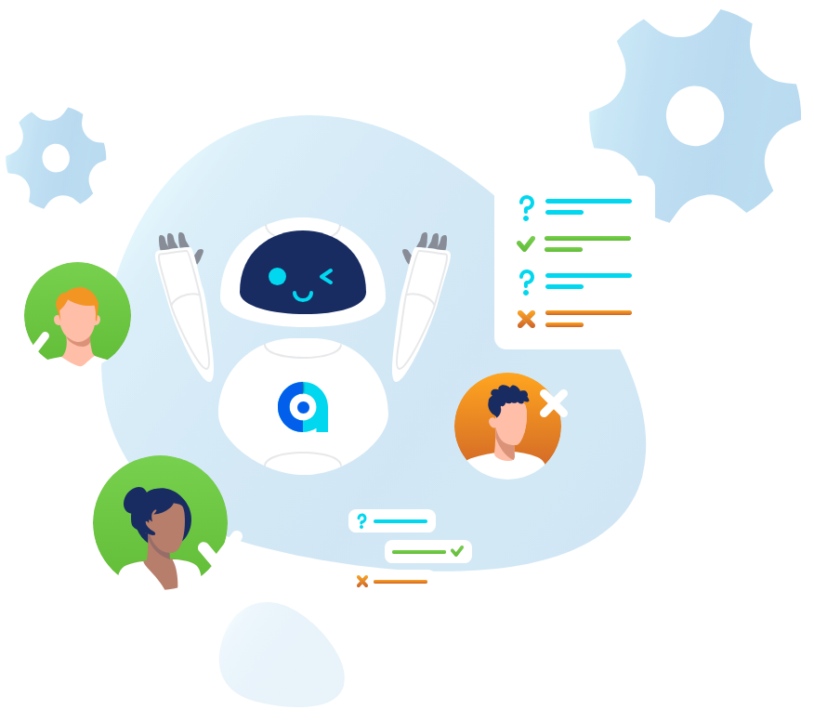
JobFit AI – AI Interviewer
🔹 Purpose – 🎯 Simulates real interviews by asking HR and technical questions.
🔹 Interview Process – ❓ Asks relevant questions based on the selected interview type (HR or Technical).
🔹 User Interaction – 👤 The user answers the questions just like in a real interview.
🔹 AI-Generated Feedback – 🤖 Provides AI-generated feedback after each response to improve answers.
🔹 Realistic Experience – 🎭 Mimics real interview scenarios to prepare users effectively.
🔹 Skill Enhancement – 🚀 Helps users refine responses and boost confidence for actual interviews.

Slide 7

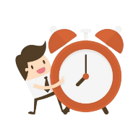
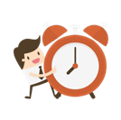

Break Time Reminder
Automated Alerts – ⏰ Notifies employees to take breaks at regular intervals to maintain productivity.
Customizable Reminders – ⚙️ Users can adjust break timings based on their work schedule.
Snooze & Dismiss Options – ⏳ Snooze for 10 seconds or stop reminders as per preference.
Health & Productivity Boost – 💡 Encourages short breaks to reduce fatigue and improve focus.
User-Friendly Interface – ✅ Simple and intuitive design for smooth usage.

Slide 8
Task Management System
Daily Task Overview Pop-up – The admin gets a pop-up notification showing the number of remaining tasks for the day.Employee Work Progress Tracking – The admin can see each employee's completed, pending, and in-progress tasks with due dates.
Work-from-Home Status – A dedicated section displays which employees are working from home.
Task Assignment & Management – The admin can assign, edit, and reassign tasks to employees based on workload.
Performance Monitoring – Visual reports and progress bars show how much work each employee has completed.
Real-Time Updates – The panel updates dynamically, ensuring the admin always sees the latest task and employee status.

Slide 9

Scope
Expansion in AI-Driven Workspaces 🤖
Increasing demand for virtual office solutions and smart automation in businesses worldwide.
Integration with Advanced Technologies 🌍
Opportunities to incorporate AI, IoT, and cybersecurity for seamless workplace management.
Market Growth & Business Adoption 📈
Rising adoption of AI-powered office solutions by startups, SMEs, and enterprises, driving long-term scalability.

Slide 10
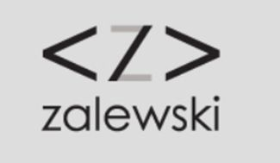
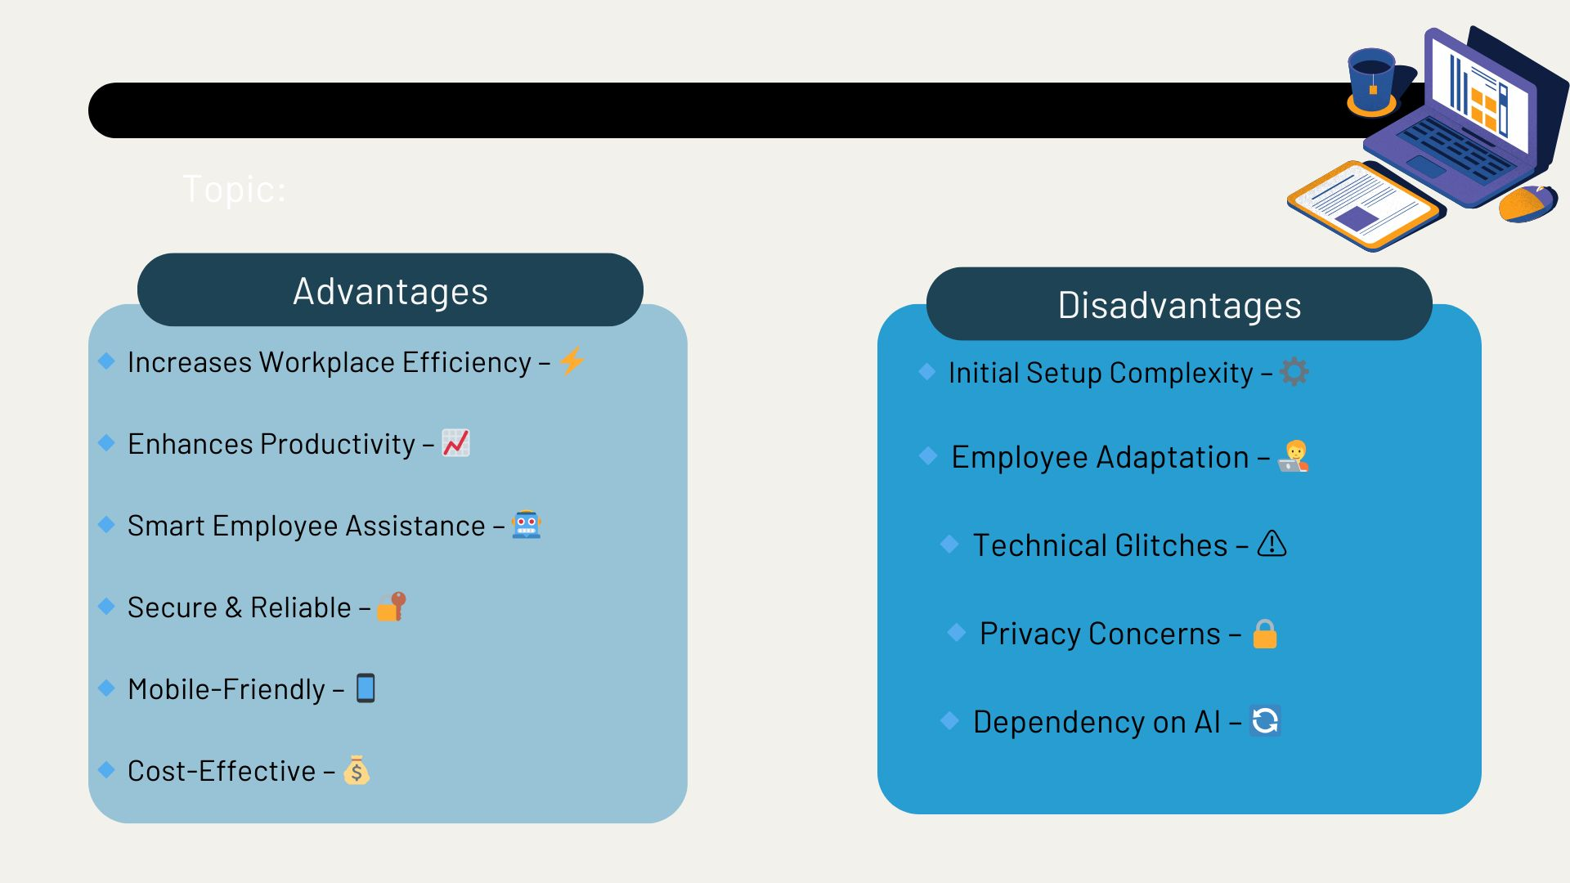

Slide 11

THANK
YOU
FOR
YOUR
ATTENTION

